Slide 1


ProfitPulse:
"Dynamics of Market Expansion"

Slide 2


01.
Track : Data Analyst Specialist
02.
Group : CAI1_DAT1_G9d
03.
Provider : AST
04.
Instructor : Eng. Ahmed Abdulatif
05.
Data Source: Link

Slide 3


Hossam
Ali
Mohamed
Reham

Slide 4


Overview
This comprehensive dataset offers a deep dive into US startup dynamics, revealing how marketing strategies impact retail revenue and assessing the viability of new ventures across diverse regions and industries. By analyzing factors like location, startup type, company size, and challenges, you'll gain invaluable insights into the keys to success for both established businesses and emerging startups.

Slide 5

Mission
Our mission is to provide actionable analytics that help startups optimize operations, enhance market positioning, and achieve sustainable growth. By harnessing advanced technologies, we foster a data-driven culture that empowers entrepreneurs to succeed.

Slide 6

1
2
Analysis process
Problem Definition
Importing
Data
3
4
5
Cleaning Data
EDA
Visualization

Slide 7

Insights:
-The total marketing spend is $5,066,870. This represents the cumulative amount invested in marketing across all channels or regions
-The average revenue is $34,866. This figure reflects the mean revenue generated across all relevant stores, locations, or business segments.
-The total number of startups is 2,000. This indicates the overall scale of businesses or projects included in the dataset.
-The maximum Return on Investment (ROI) is 27.21%. This indicates the highest ROI achieved among all the entities within the dataset.
-Percentage of Old Expansions: 93.50% This indicates that most existing entities or stores are part of the old expansion phase.
-Percentage of New Expansions: 6.50% A smaller proportion of entities are new expansions, representing recent growth or additions.

Slide 8
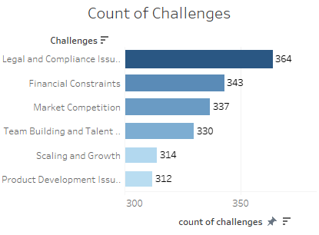
Overview of Market Challenges:
Main Challenges Faced by Startups:
Legal and Compliance Issues (364 instances): This is the most frequent challenge, indicating that regulatory hurdles and legal complexities are significant concerns for startups.
Financial Constraints (343 instances): A close second, this challenge highlights issues related to funding, cash flow management, and financial sustainability.
Recommendations:
For Legal and Compliance Issues:
Legal Advisory Services: Startups should engage with legal professionals to navigate the complex regulatory landscape. This can include ongoing consultations or hiring a dedicated legal advisor.
Compliance Automation Tools: Implement software tools that help ensure compliance with regulations automatically, reducing the burden and risk of non-compliance.
For Financial Constraints:
Diverse Financing Options: Explore a mix of funding sources, including angel investors, venture capital, crowdfunding, and government grants, to reduce reliance on limited financial avenues.
Financial Literacy Programs: Conduct workshops and training in financial management for startup founders and key employees to enhance their understanding of financial planning, budgeting, and cash flow management.

Slide 9
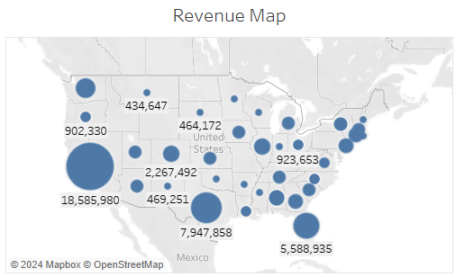
Geographical Revenue Insights:
Geographic Revenue Concentration:
The highest revenue concentration is noted in the California with $18,585,980, suggesting this area as a major market or hub for the business activities covered.
Other significant revenue figures include $7,947,858 and $5,588,935 in Texas and Florida indicating strong market penetration or key customer bases in these regions.
Recommendations:
Expand Market Efforts: Increase marketing and sales efforts in areas with the highest revenue such as the Midwest and specific spots in Mexico to capitalize on existing demand and further increase market share.
Resource Allocation: Shift resources, including manpower and advertising dollars, towards these high-revenue regions to maximize returns.
Targeted Marketing Campaigns: Develop targeted marketing campaigns for areas with lower revenues to boost brand awareness and sales. These campaigns should be tailored to local market needs and consumer preferences.
Localized Product Offerings: Consider offering products or services tailored to the unique needs of these regions to increase appeal and adoption.
Market Research: Conduct detailed market research to understand the factors driving revenue in high-performing regions and apply these insights to less penetrated areas.

Slide 10
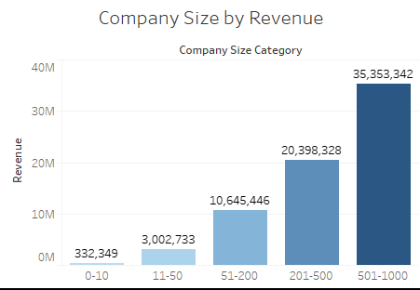
Company Size and Revenue Analysis:
Revenue Correlation with Company Size:
The chart shows a clear trend where revenue significantly increases with the size of the company. Companies in the 501-1000 employee range generate the highest revenue at approximately $35.35 million.
Smaller companies, particularly those with 0-10 employees, generate substantially lower revenue
Recommendations:
Business Development Support: Smaller companies could benefit from business development programs that focus on scaling up operations, strategic planning, and market expansion.
Niche Targeting: Advise small companies to target niche markets where competition from larger companies might be less intense, allowing for more controlled growth and brand development.
Global Market Expansion: Medium and large companies should be encouraged to explore international markets to expand their customer base beyond local or national boundaries.
Leadership Training: Particularly for medium-sized companies looking to transition into larger enterprises, leadership training can equip their teams with the skills needed to manage larger operations and more complex market strategies.
Enhanced Customer Engagement: Utilize technology to enhance customer engagement and personalization, which can drive revenue growth, especially for companies in the mid-size range looking to expand their market share.

Slide 11
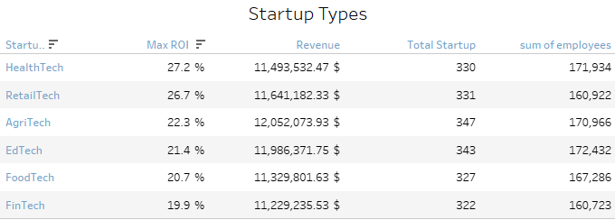
Analysis of Startup Sectors:
Revenue Correlation with Company Size:
The analysis of startup types reveals HealthTech and RetailTech as leaders in ROI at 27.2% and 26.7%, respectively, highlighting their efficient capital returns and robust market demand. AgriTech, while not the leader in ROI, boasts the highest revenue, suggesting a significant market presence and effective revenue generation strategies. Conversely, FinTech shows the lowest ROI at 19.9%, indicating potential challenges such as high competition or substantial initial investments.
Recommendations:
Sector-Specific Growth Strategies:
HealthTech and RetailTech: Focus on scaling operations and exploring new markets, given their high ROI and substantial revenue. Investing in technological innovation and expanding product lines could further enhance profitability.
FinTech: Address the relatively lower ROI by adopting strategies to reduce operational costs, perhaps through automation, and enhancing customer acquisition tactics to scale revenue.
Investment Focus:
Investors should prioritize HealthTech and RetailTech for their strong potential returns. AgriTech is also appealing, both for its profitability and its role in promoting sustainable farming practices. For FinTech, forming strategic partnerships and focusing on niche areas like blockchain and microfinancing could significantly improve returns.

Slide 12
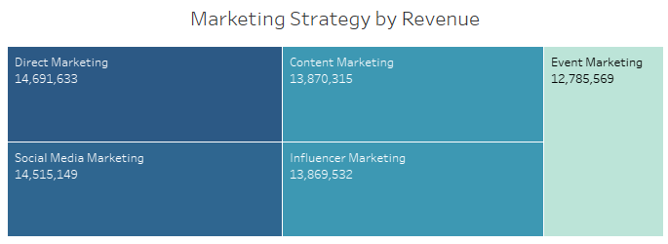
Marketing Strategy Efficacy:
Insights from Marketing Strategy by Revenue:
The data shows that Direct Marketing ($14,691,633) and Social Media Marketing ($14,515,149) generate the highest revenue among the marketing strategies listed. This suggests that these methods are particularly effective in reaching and engaging customers. Content Marketing and Influencer Marketing also perform well, generating revenues of $13,870,315 and $13,869,532, respectively, indicating strong potential in these areas for storytelling and brand influence. Event Marketing, while slightly lower at $12,785,569, still plays a significant role in the overall marketing mix.
Recommendations:
Given the effectiveness of Direct and Social Media Marketing in driving revenue, businesses should consider allocating a larger portion of their marketing budget to these channels to maximize ROI. Enhancing strategies in Content and Influencer Marketing can also be beneficial, focusing on creating high-quality, engaging content and collaborating with influencers who resonate well with the target audience. For Event Marketing, exploring more integrated and interactive approaches or hybrid events could potentially increase its impact and revenue generation.

Slide 13
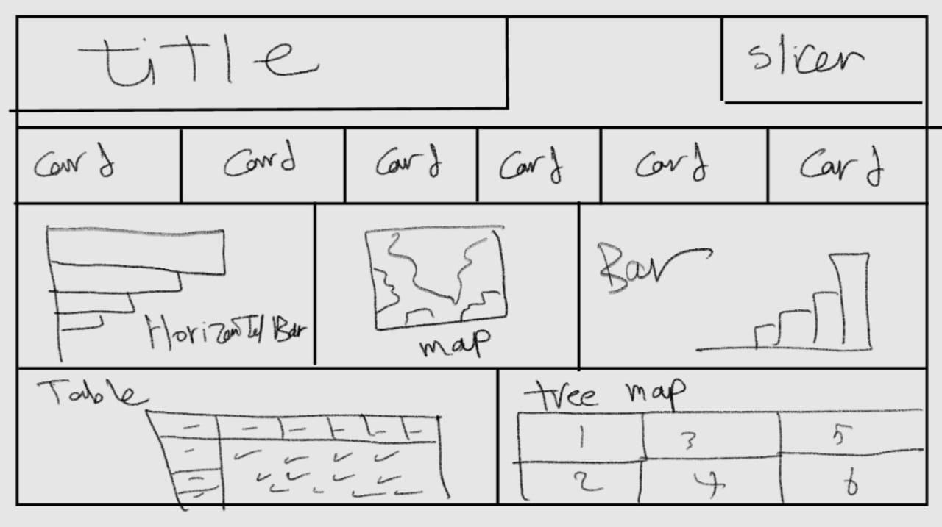
Blueprint :

Slide 14
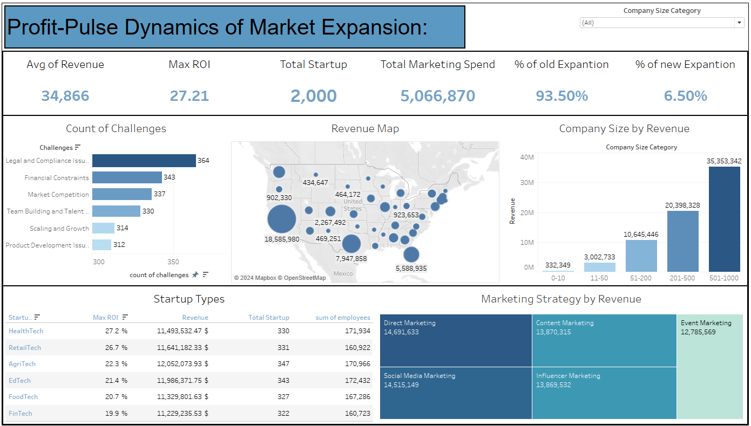
Dashboard :

Slide 15


Any Questions?

Slide 16

Thank you very much!

